Slide 1
sparkmagic
Impact of Temperature on Demographics and Death Rates in Minnesota — 10 Year Analysis
Presented By:
Karrin Connors, Linda Reber, Carl Adams, Messac Che Neba

Slide 2
Research Question
Background
Hypothesis
Anecdotal observations may suggest that there is a correlation between temperature, time of year and death rates among older adults (75+)
Temperature and time of the year impacts death rate for older adults in Minnesota

Slide 3
Data Selection & Sources
Focused on Minnesota — by month and age group for the past 10 years
Temperature data from the National Weather Service
Death rates data from Center for Disease Control and Prevention

Slide 4
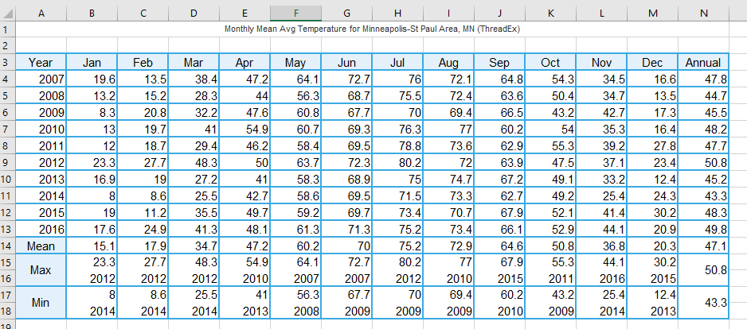
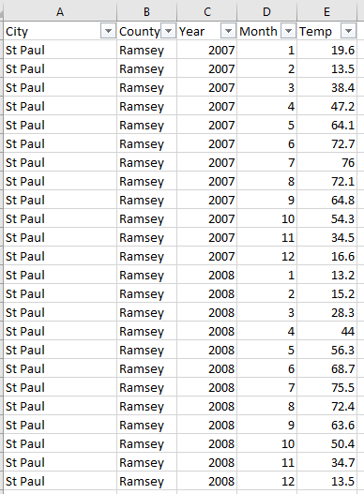
Data Cleaning And Assembly
Weather Data Transformation

Slide 5
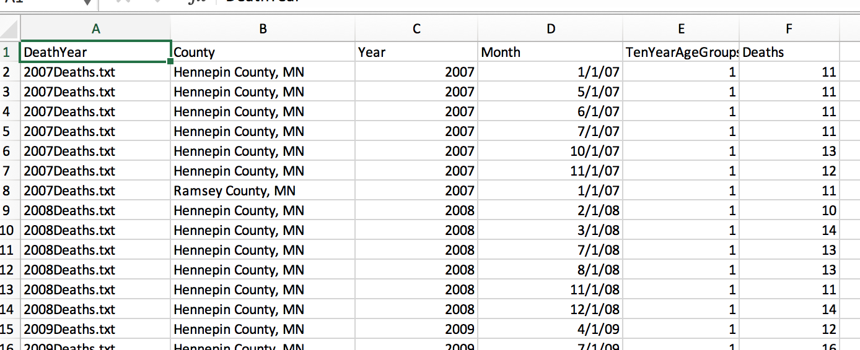
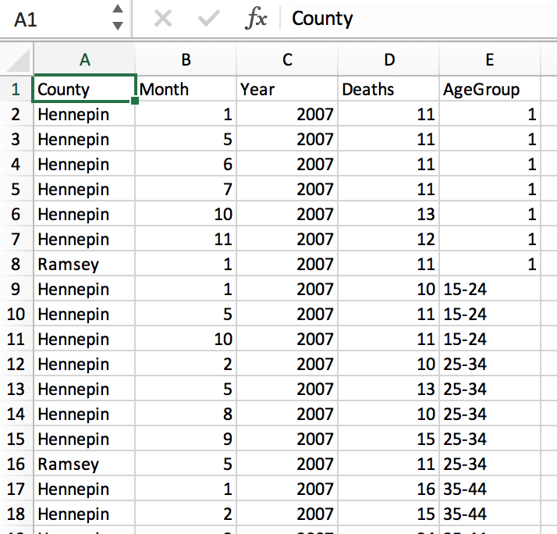
Data Cleaning And Assembly
Death Data Transformation

Slide 6
Data Analysis
Tools
Python Code
Pandas DataFrame
Jupyter Notebook
Matplotlib & Numpy & Scipy
GitHub

Slide 7
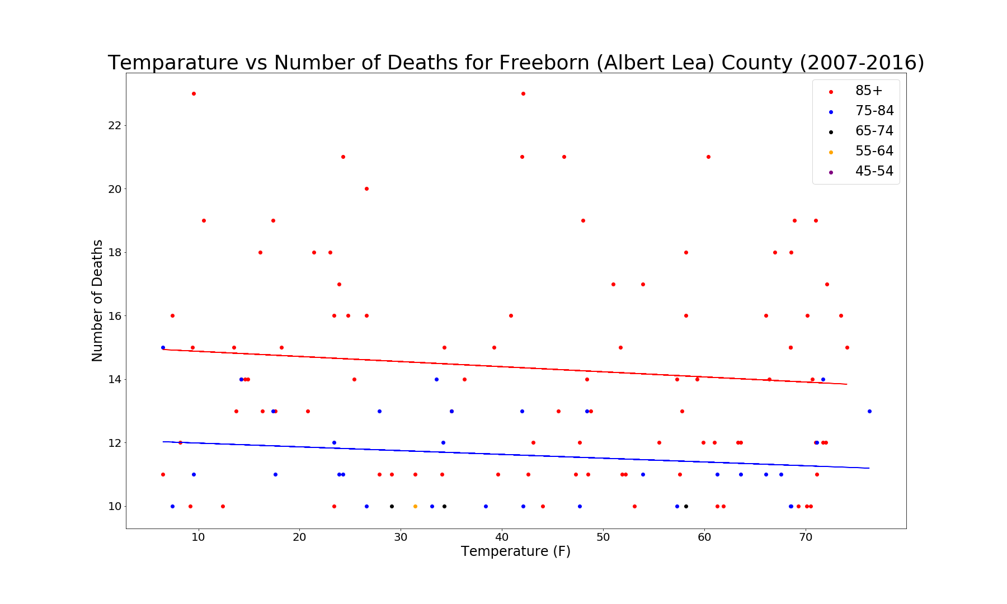
Freeborn County Death Counts
For 85 + [ R2 = 0.010 | P-value – 0.331 ]
For 75 - 84 [ R2 = 0.029 | P-value – 0.355 ]

Slide 8
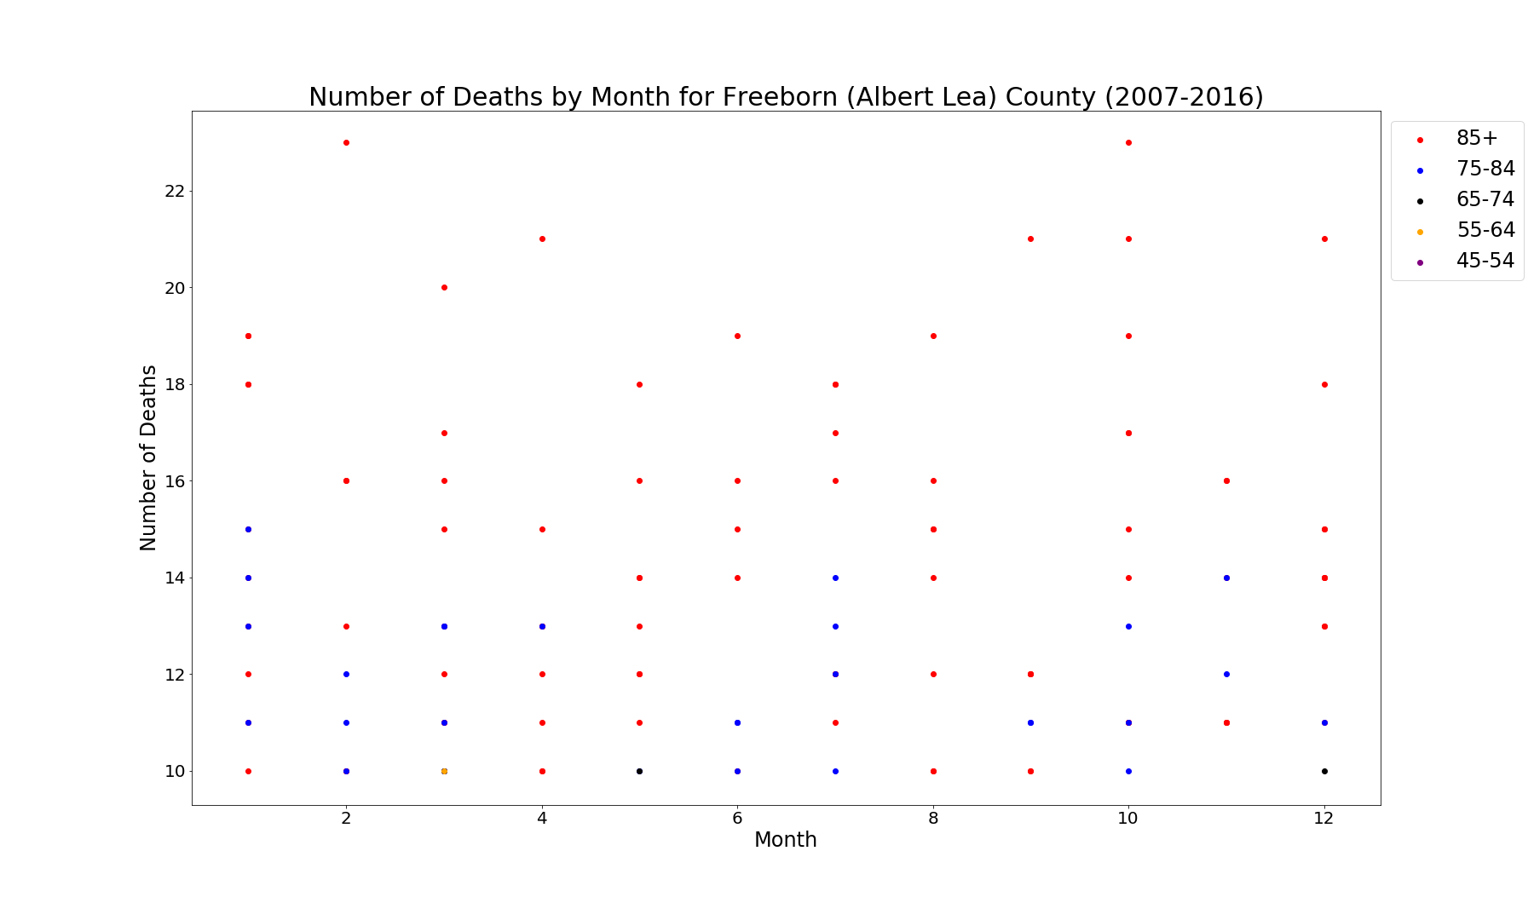
Freeborn County Monthly Death Counts

Slide 9
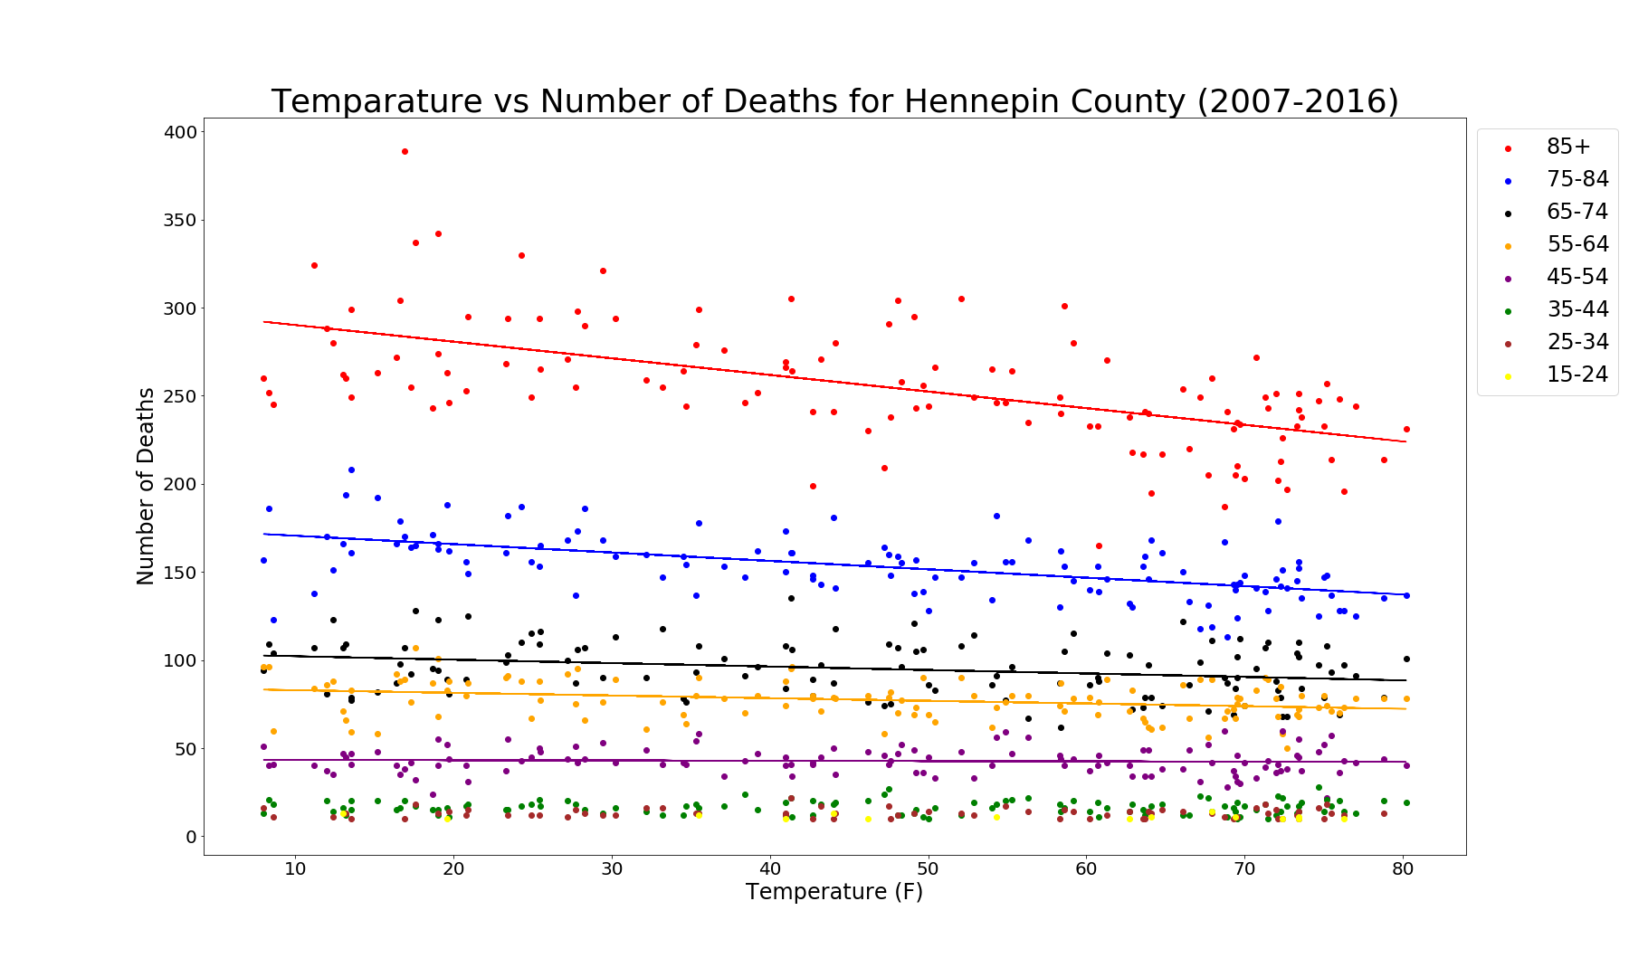
Hennepin County Temp Vs Death Count — Correlates with Minnesota trends
For 85+ [ R² = 0.344 | P-value = 1.886e-12 ]
For 75 – 84 [R² = 0.337 | P-value = 3.482e-12 ]
For 65 – 74 [R² = 0.075 | P-value = 0.00234 ]
For 55 – 64 [R² = 0.093 | P-value = 0.00067 ]
For 45 – 54 [R² = 0.002 | P-value = 0.59459 ]

Slide 10
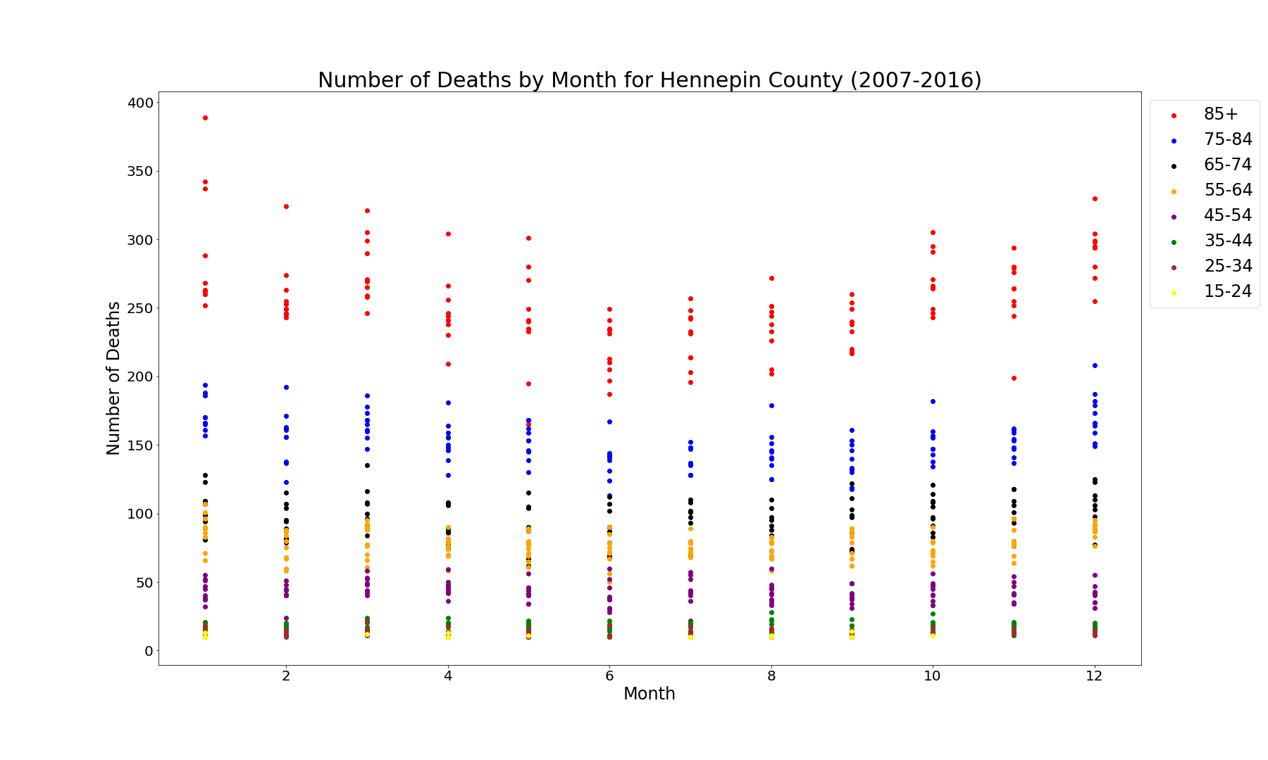
Hennepin County Temp Vs Death Count — Correlates with Minnesota trends

Slide 11
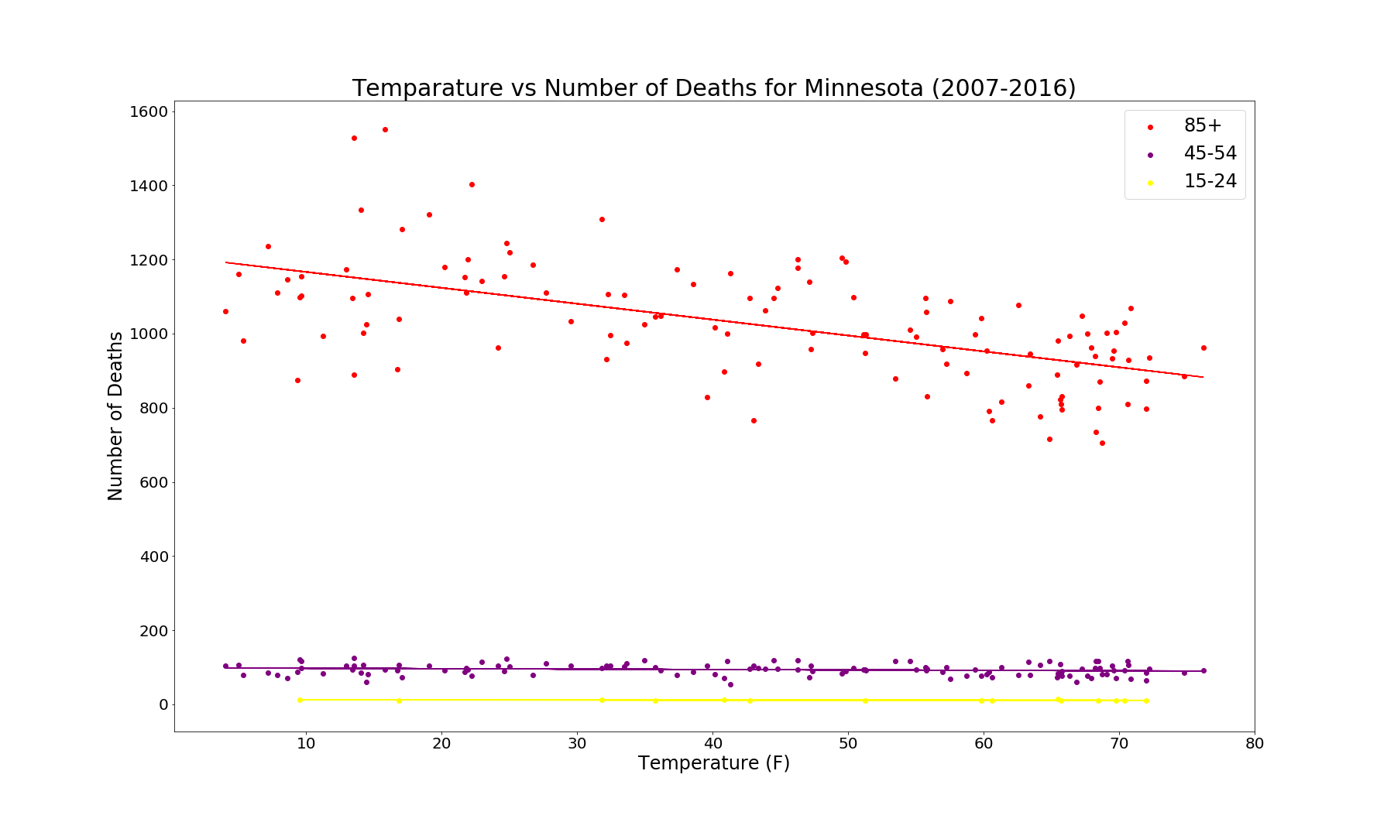
Minnesota Temp Impacts Death Counts
For 85+ [ R² = 0.343 | P-value = 2.085e-12 ]
For 45 – 54 [R² = 0.025 | P-value = 0.08409 ]
For 15 - 24 [R² = 0.053 | P-value = 0.40509 ]

Slide 12
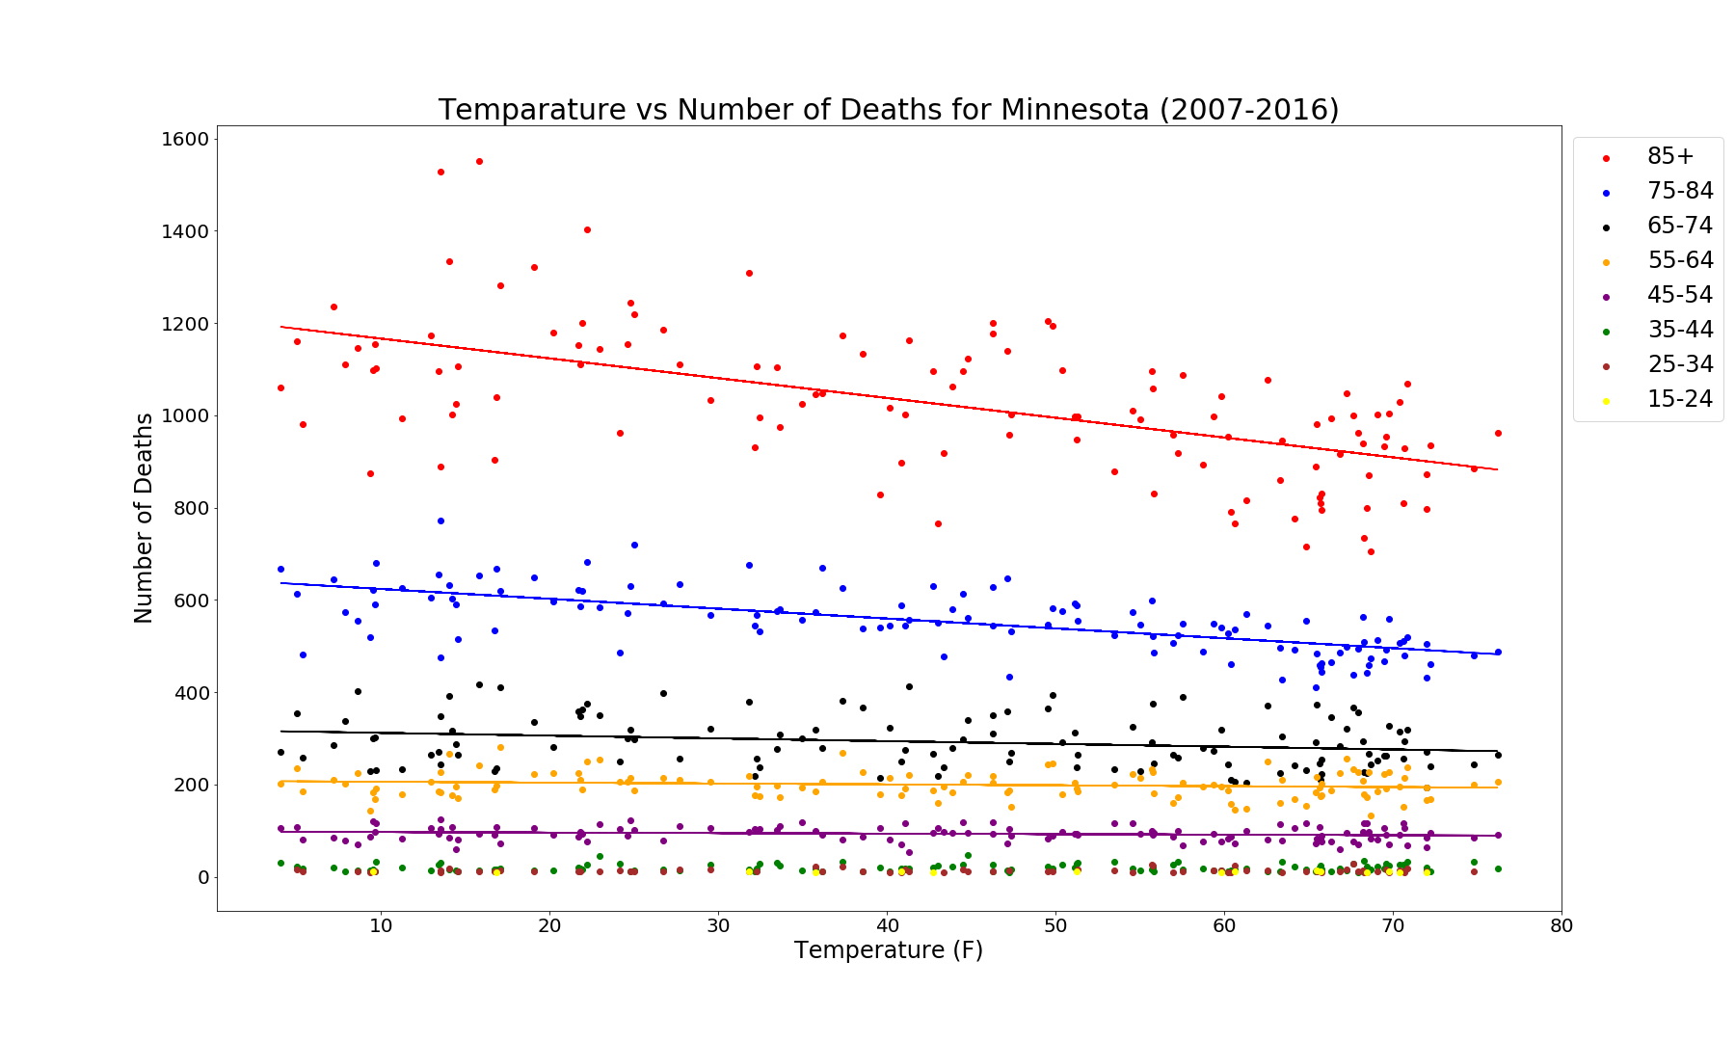
Minnesota Temp Impacts Death Counts across age groups
For 85+ [ R² = 0.343 | P-value = 2.085e-12 ]
For 75 – 84 [R² = 0.440 | P-value = 1.499e-16 ]
For 65 – 74 [R² = 0.053 | P-value = 0.01071 ]
For 55 – 64 [R² = 0.021 | P-value = 0.10703 ]
For 45 – 54 [R² = 0.025 | P-value = 0.08409 ]

Slide 13
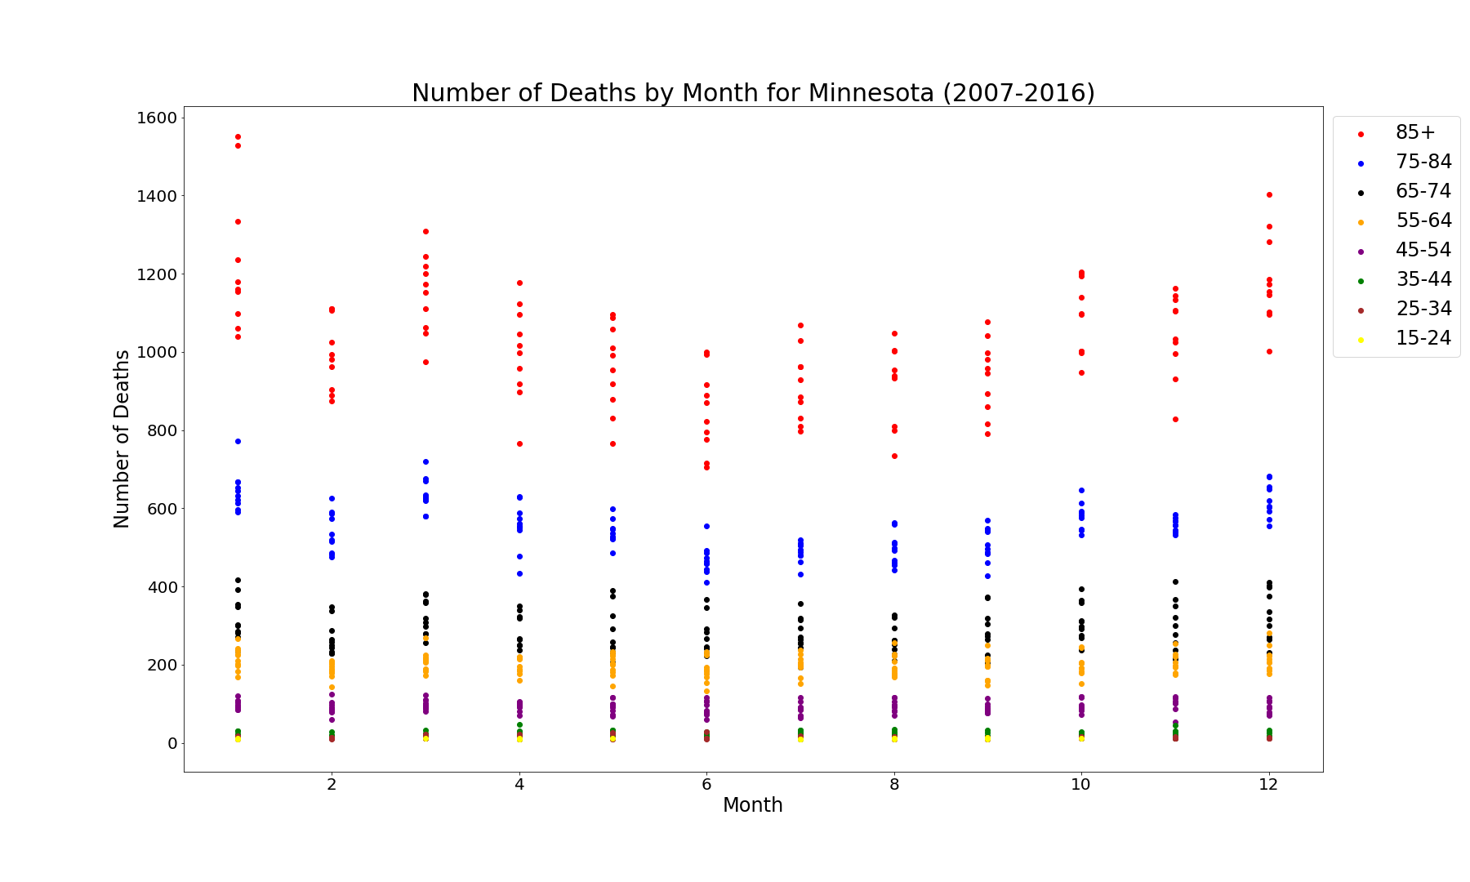
Minnesota Death Counts By Month

Slide 14
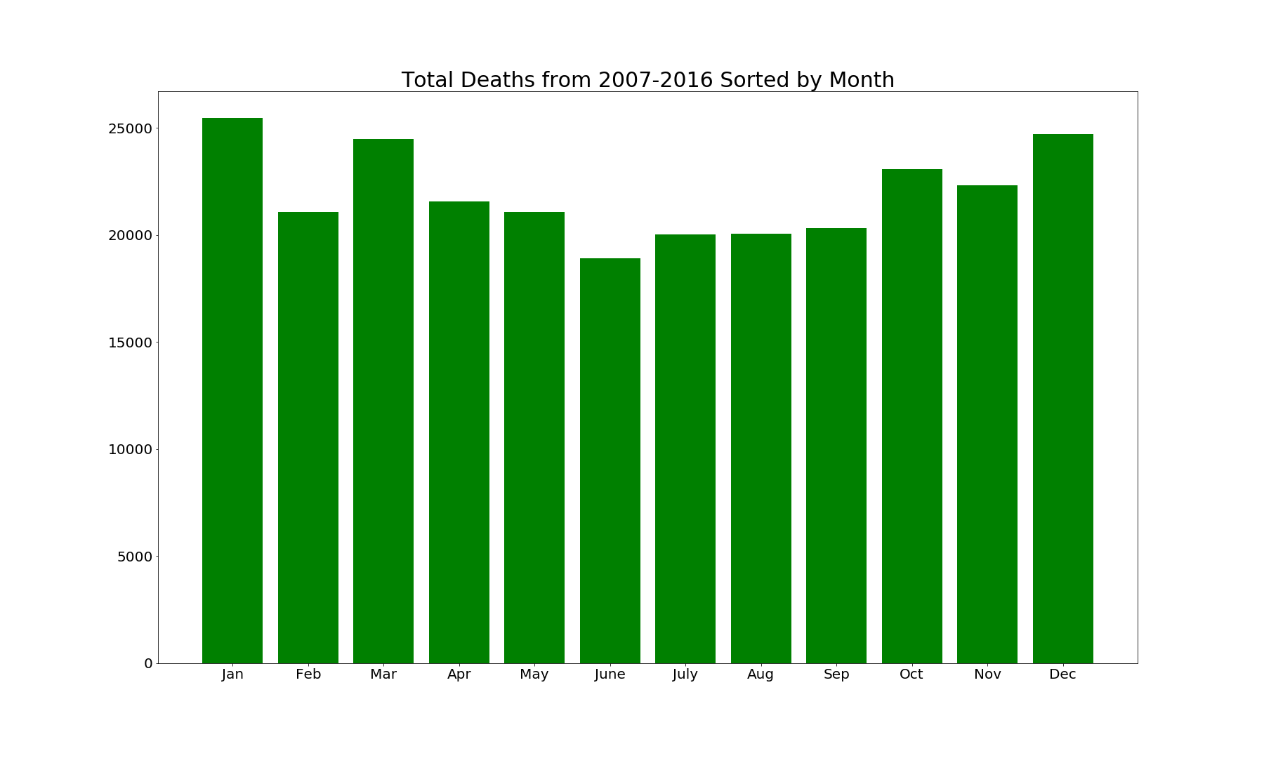
Minnesota Total Deaths By Month
Winter Months
Winter Months
Spring, Winter & Fall Months

Slide 15
Interpretation of Findings
For Ages 65+ P-value < 0.05 indicates:
Death rate is inversely proportional to temperature
Ages 65+ are significantly more susceptible to death during colder months than children or young adults.
January appears to be the deadliest month across Minnesota
June appears to be the happiest month across Minnesota

Slide 16

Thank you!!!

Slide 17
Q & A

